Slide 1
Coding Solutions to Philosophers problem
Nasir Jones

Slide 2
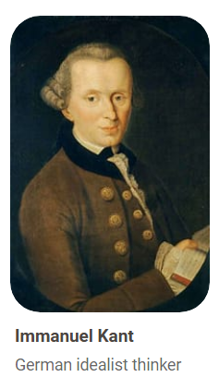


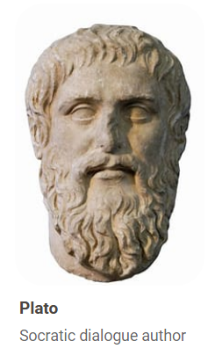
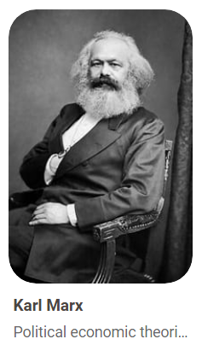
Meet our philosphers and their deadlock
Deadlocks can occur in a system when multiple processes compete for limited resources. Each philosopher represents a process, and each fork represents a shared resource. Each philosopher picks up one fork and waits for another, creating a circular dependency where no one can proceed.

Slide 3
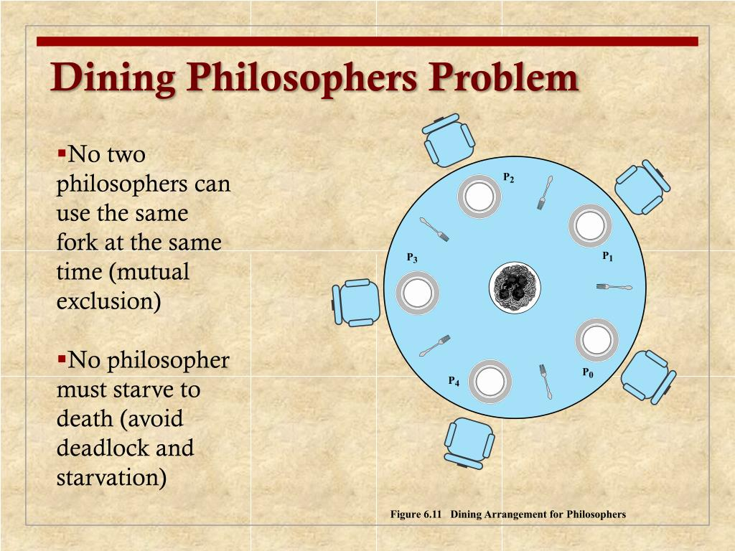
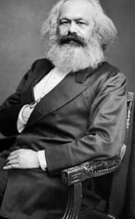
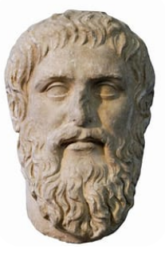
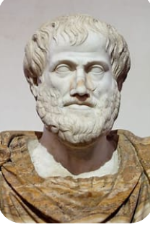

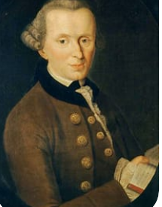

Slide 4
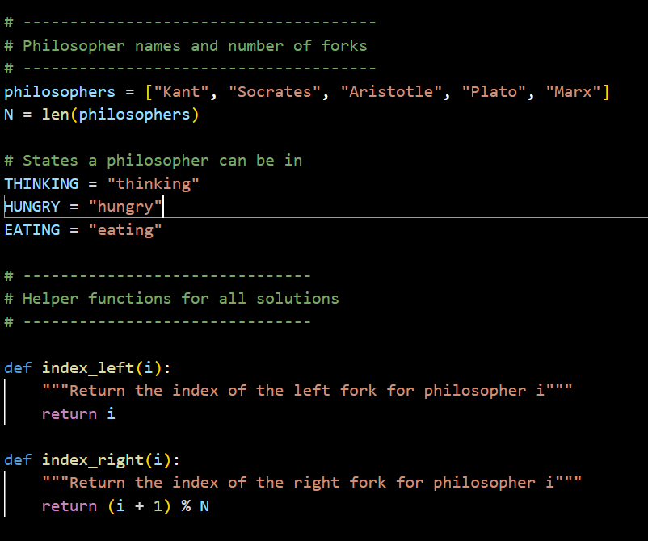
Setting the table

Slide 5
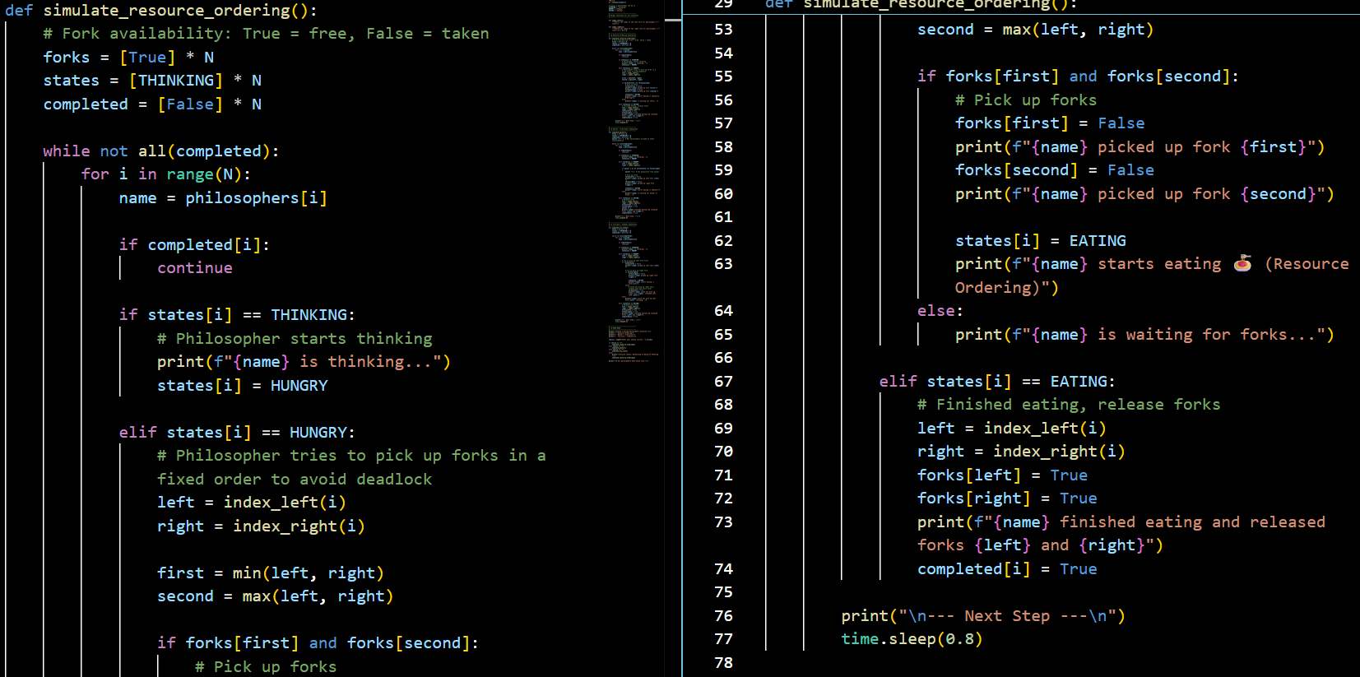
Resource Ordering (Circular Wait Prevention)
Force philosophers to pick up forks in a fixed order (e.g., always pick the lower-numbered fork first).

Slide 6
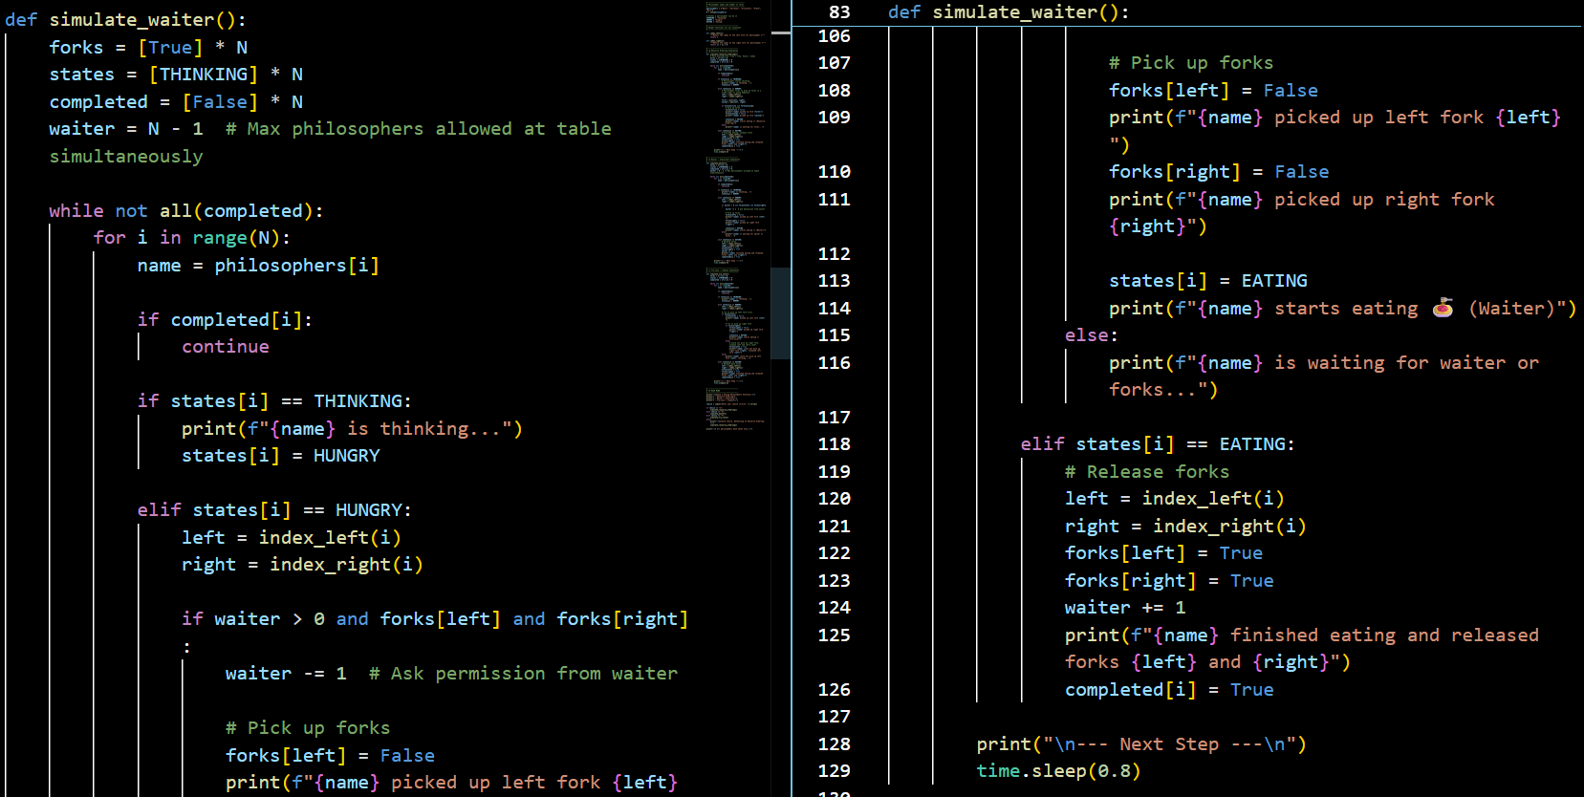
Waiter/ Semaphore
a “waiter” (or semaphore) that only allows N-1 philosophers to try to eat at once.

Slide 7
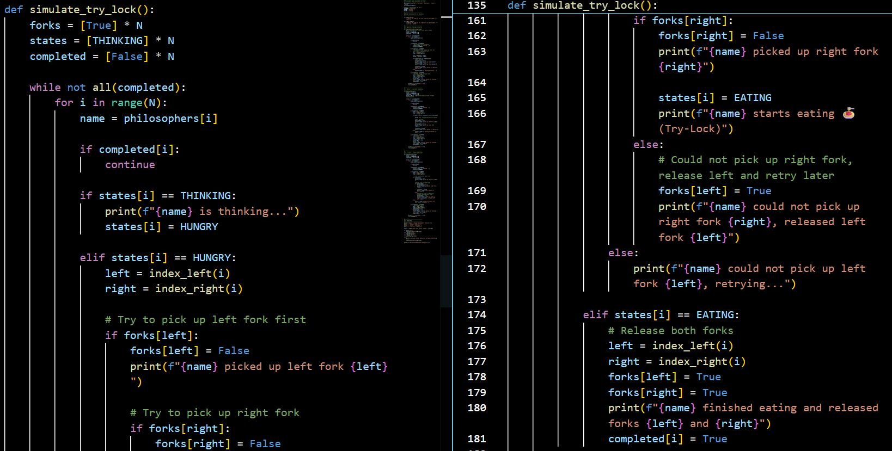
Timeout Solution
Force philosophers to pick up forks in a fixed order (e.g., always pick the lower-numbered fork first).

Slide 8
Copy me for live demo
import time
# --------------------------------------
# Philosopher names and number of forks
# --------------------------------------
philosophers = ["Kant", "Socrates", "Aristotle", "Plato", "Marx"]
N = len(philosophers)
# States a philosopher can be in
THINKING = "thinking"
HUNGRY = "hungry"
EATING = "eating"
# -------------------------------
# Helper functions for all solutions
# -------------------------------
def index_left(i):
"""Return the index of the left fork for philosopher i"""
return i
def index_right(i):
"""Return the index of the right fork for philosopher i"""
return (i + 1) % N
# -------------------------------
# 🥇 Resource Ordering Simulation
# -------------------------------
def simulate_resource_ordering():
# Fork availability: True = free, False = taken
forks = [True] * N
states = [THINKING] * N
completed = [False] * N
while not all(completed):
for i in range(N):
name = philosophers[i]
if completed[i]:
continue
if states[i] == THINKING:
# Philosopher starts thinking
print(f"{name} is thinking...")
states[i] = HUNGRY
elif states[i] == HUNGRY:
# Philosopher tries to pick up forks in a fixed order to avoid deadlock
left = index_left(i)
right = index_right(i)
first = min(left, right)
second = max(left, right)
if forks[first] and forks[second]:
# Pick up forks
forks[first] = False
print(f"{name} picked up fork {first}")
forks[second] = False
print(f"{name} picked up fork {second}")
states[i] = EATING
print(f"{name} starts eating (Resource Ordering)")
else:
print(f"{name} is waiting for forks...")
elif states[i] == EATING:
# Finished eating, release forks
left = index_left(i)
right = index_right(i)
forks[left] = True
forks[right] = True
print(f"{name} finished eating and released forks {left} and {right}")
completed[i] = True
print("\n--- Next Step ---\n")
time.sleep(0.8)
# -------------------------------
# 🥈 Waiter / Arbitrator Simulation
# -------------------------------
def simulate_waiter():
forks = [True] * N
states = [THINKING] * N
completed = [False] * N
waiter = N - 1 # Max philosophers allowed at table simultaneously
while not all(completed):
for i in range(N):
name = philosophers[i]
if completed[i]:
continue
if states[i] == THINKING:
print(f"{name} is thinking...")
states[i] = HUNGRY
elif states[i] == HUNGRY:
left = index_left(i)
right = index_right(i)
if waiter > 0 and forks[left] and forks[right]:
waiter -= 1 # Ask permission from waiter
# Pick up forks
forks[left] = False
print(f"{name} picked up left fork {left}")
forks[right] = False
print(f"{name} picked up right fork {right}")
states[i] = EATING
print(f"{name} starts eating (Waiter)")
else:
print(f"{name} is waiting for waiter or forks...")
elif states[i] == EATING:
# Release forks
left = index_left(i)
right = index_right(i)
forks[left] = True
forks[right] = True
waiter += 1
print(f"{name} finished eating and released forks {left} and {right}")
completed[i] = True
print("\n--- Next Step ---\n")
time.sleep(0.8)
# -------------------------------
# 🥉 Try-Lock / Timeout Simulation
# -------------------------------
def simulate_try_lock():
forks = [True] * N
states = [THINKING] * N
completed = [False] * N
while not all(completed):
for i in range(N):
name = philosophers[i]
if completed[i]:
continue
if states[i] == THINKING:
print(f"{name} is thinking...")
states[i] = HUNGRY
elif states[i] == HUNGRY:
left = index_left(i)
right = index_right(i)
# Try to pick up left fork first
if forks[left]:
forks[left] = False
print(f"{name} picked up left fork {left}")
# Try to pick up right fork
if forks[right]:
forks[right] = False
print(f"{name} picked up right fork {right}")
states[i] = EATING
print(f"{name} starts eating (Try-Lock)")
else:
# Could not pick up right fork, release left and retry later
forks[left] = True
print(f"{name} could not pick up right fork {right}, released left fork {left}")
else:
print(f"{name} could not pick up left fork {left}, retrying...")
elif states[i] == EATING:
# Release both forks
left = index_left(i)
right = index_right(i)
forks[left] = True
forks[right] = True
print(f"{name} finished eating and released forks {left} and {right}")
completed[i] = True
print("\n--- Next Step ---\n")
time.sleep(0.8)
# -------------------------------
# 🔘 MAIN MENU
# -------------------------------
print("\nChoose a Dining Philosophers Solution:\n")
print("1 - Resource Ordering")
print("2 - Waiter / Arbitrator")
print("3 - Try-Lock / Timeout\n")
choice = input("Enter your choice (1/2/3): ").strip()
if choice == "1":
simulate_resource_ordering()
elif choice == "2":
simulate_waiter()
elif choice == "3":
simulate_try_lock()
else:
print("\nInvalid choice. Defaulting to Resource Ordering.\n")
simulate_resource_ordering()
print("\n✅ All philosophers have eaten once.\n")

